Slide 1
URL for video:
https://youtu.be/jVAg9ngf4SM

Slide 2
Group Breakdown
Use Cases, Ai Collab,
Conclusions,
Presentation
Architecture,
Diagrams, Use Cases
Abstract, Introduction,
Presentation
External Interfaces, Architecture, Data Dictionary
Outline, Research
Chat GPT 5.0
Karim Sponheimer
Presenter
Zachary Stephens
Group leader
Kasia Zaski
Presenter
Zirui Wang

Slide 3


Conceptual Architecture
Group Name: Potential Guacamole
Void AI
Group 14: Karim Sponheimer, Zachary Stephens, Zirui Wang, Kasia Zaski
Notes:
Country Bumkin

Slide 4
Abstract
Analyzed Void, an open source, AI powered IDE forked from VS Code
Explored architecture principles
Key Insights
Renderer, Main, Extension Host Separation
AI integration via Provider Adapters
Deliverables
Lessons Learned
Notes:
Country Bumpkin

Slide 5
Introduction/Overview
VS Code: Lightweight, extensible editor
Void IDE: adds AI assistant whole keeping privacy, customization, and open source model
Project goal: Apply IDE architecture principles to a web based project
Layered structure
Self contained component
Demonstrates separation of concerns and modularity
Report structure
Notes:
Country Bumpkin

Slide 6
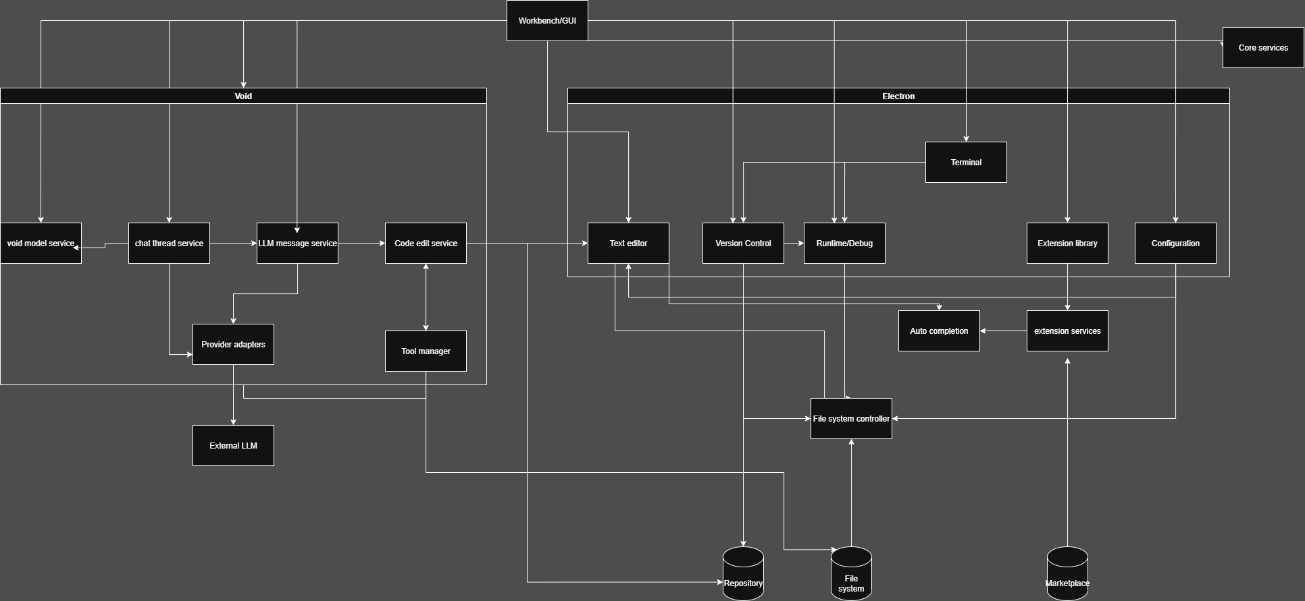
Conceptual Architecture
Company Name
Date
1. Add section title
2. Add section title
Notes:
Karim

Slide 7
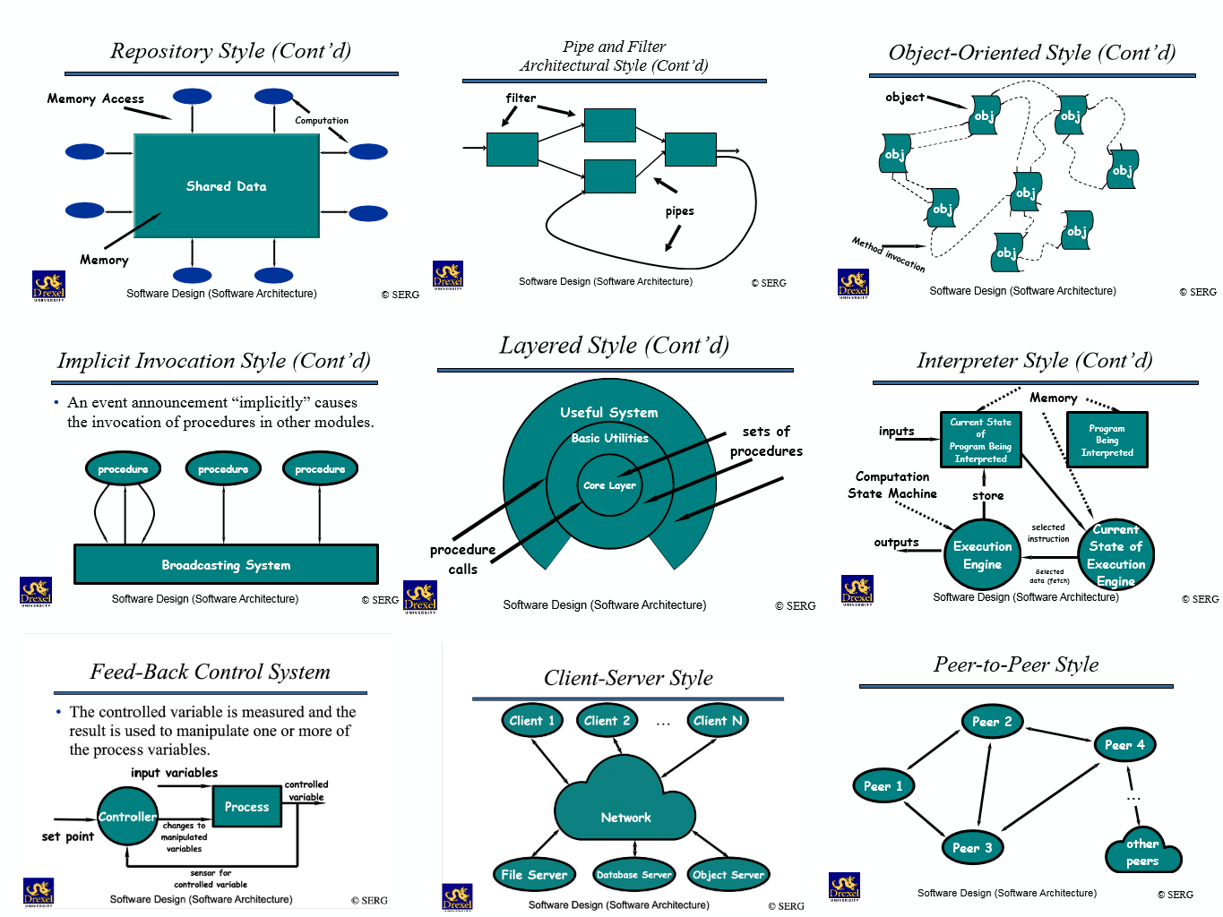
Architecture Style
1. Layered
Renderer manages user interface and panels.
Core Services handle editing logic, chat, and message flow.
Main Process (Electron) handles file access and LLM connections.
2. Implicit Invocation (Pub-Sub)
Event-driven design for extensions, AI providers, and chat interactions.
Allows components to react dynamically to user actions or system events.
Notes:
Country Bumpkin

Slide 8
Subsystem Overview
Renderer / Workbench UI: Manages the visible interface including chat, diff previews, and panes.
Core Services: Handles document state, editing buffers, LLM message handling, and version control.
Main Process (Electron): Executes system-level tasks like file I/O and API communication.
Extension Host: Runs extensions safely in a sandbox to protect performance and security.
Provider Adapters: Bridge between Void and external or local LLMs (OpenAI, Anthropic, etc.).
Notes:
Country Bumpkin

Slide 9
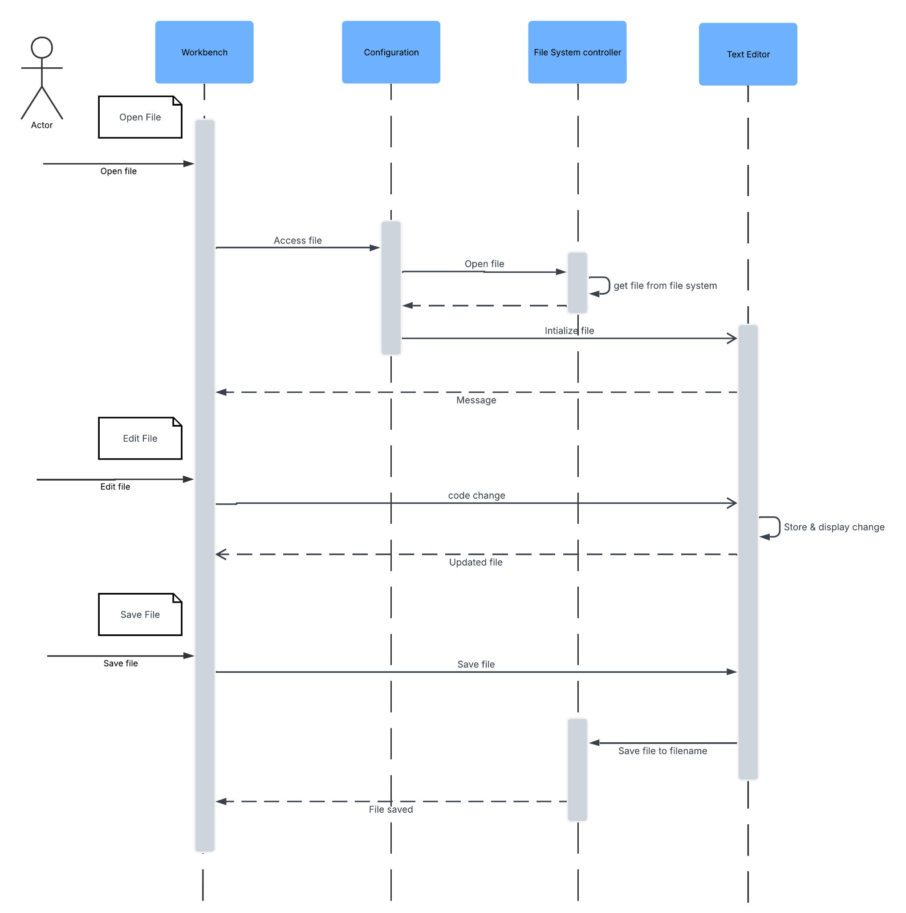
Use Case 1
Open, Edit, and Save a File
User opens a file from the workspace through the Renderer (UI).
Renderer sends request to Core Services, which checks cache or disk.
Core communicates with the Electron Main Process to read or write files.
Main Process performs system-level file I/O and returns confirmation.
Renderer updates the editor view once the file is opened or saved.
Demonstrates the layered flow between UI, logic, and system access.
Notes:
Karim

Slide 10
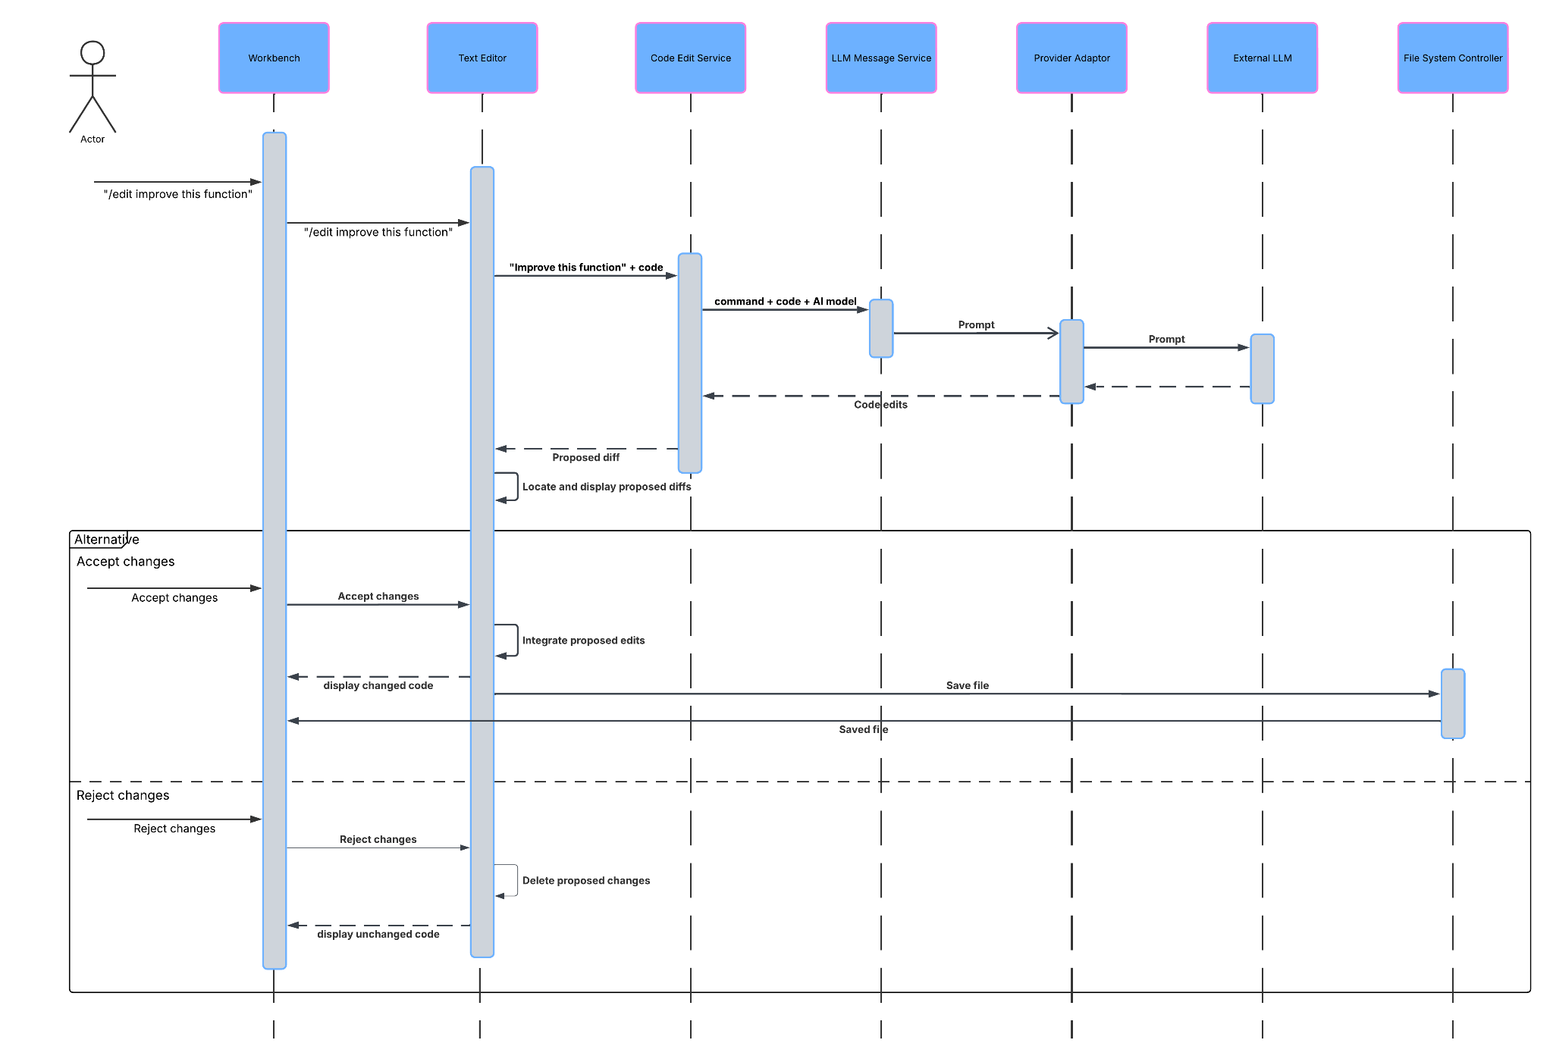
Use Case 2
Chat (/edit) AI Suggestion and Apply
User types /edit command in the chat panel requesting a code change.
Renderer passes request and code context to Core editing service.
Core sends request through Main Process to the selected AI provider.
Provider streams code suggestions back to the Core and Renderer.
User previews suggested edits in the editor’s diff view.
On approval, Core applies the new code to the text buffer and saves.
Shows implicit invocation and real-time, event-driven interaction between components.
Notes:
Karim

Slide 11
External Interfaces
Graphical Interface: Same layout as VS Code but adds AI chat panels, inline diffs, and checkpoints.
APIs: Supports LLM providers and extensions via REST or streaming connections.
File System: Unified handling for local, remote, and cloud-based files.
OS Integration: Clipboard, terminal, and process execution managed through Electron.
Privacy Focus: Direct communication with model providers, no centralized proxy.
Notes:
Country Bumpkin

Slide 12
Lessons Learned
Creating diagrams clarified how Void extends VS Code’s architecture.
Separating inherited vs new components was complex but rewarding.
AI teammates help accelerate planning but must be carefully guided.
Strong collaboration even with a smaller group can create success.
Notes:
Karim

Slide 13
Conclusions
Void uses a layered architecture that provides separation of concerns and easy maintainability.
The implicit invocation style enables responsive, event-based communication, ideal for AI streaming and plugin integration.
Each subsystem handles distinct roles: Renderer for UI, Core for logic, Main for system access, and Provider Adapters for LLM connections.
Architecture supports key goals: extensibility, privacy, and flexibility for AI workflows.
Electron introduces some performance overhead but gives cross-platform consistency.
Future improvements could include optimizing caching, improving IPC efficiency, and reducing runtime weight.
Overall, Void’s architecture successfully merges classic IDE design with modern AI functionality.
Notes:
Karim

Slide 14
AI Collab
Used ChatGPT (GPT-5) as an AI teammate to help plan and organize the report.
Included the official project guidelines and our team outline in prompts.
AI produced a detailed report structure with section summaries and estimated lengths.
Helped us connect Void’s architecture to Visual Studio Code and Electron.
Only one member interacted with the AI; group reviewed and edited all outputs.
AI contributed mainly to organization and outline development.
Improved efficiency and clarity but needed fact-checking and context for accuracy.
Best used as a research and planning assistant, not a substitute for technical work.
Notes:
Karim

Slide 15
References
[1] “Understanding Visual Studio Code Architecture.” (n.d.). Medium. Retrieved from https://franz-ajit.medium.com/understanding-visual-studio-code-architecture-5fc411fca07 Medium
[2] “VSCode · Delft Students on Software Architecture – delftswa.” (n.d.). Delft SWA / DESOSA. Retrieved from https://delftswa.gitbooks.io/desosa-2017/content/vscode/chapter.html DelftSwa
[3] “VSCode – From Vision to Architecture.” (2021). DESOSA Project. Retrieved from https://2021.desosa.nl/projects/vscode/posts/essay2/ DESOSA
[4] “Void Editor – Architecture Overview.” (n.d.). DeepWiki. Retrieved from https://deepwiki.com/voideditor/void/1.1-getting-started#architecture-ov8631-AE22erview
[5] “Visual Studio Code – Wiki.” (n.d.). GitHub. Retrieved from https://github.com/microsoft/vscode/wiki/
[6] “Void – GitHub Repository.” (n.d.). GitHub. Retrieved from https://github.com/voideditor/void/
[7] “Electron: Things to Watch Out for Before You Dive In.” (n.d.). Medium. Retrieved from https://medium.com/@vishaldwivedi13/electron-things-to-watch-out-for-before-you-dive-in-e1c23f77f38f medium.com
[8] “Void IDE: The Comprehensive Guide to the Open-Source Cursor Alternative.” (n.d.). Medium. Retrieved from https://medium.com/@adityakumar2001/void-ide-the-comprehensive-guide-to-the-open-source-cursor-alternative-2a6b17cae235

